Slide 1
Lecture 4 Visualizing & standardizing serological data
May 22, 2025
Seroanalytics Training Blantyre, Malawi
Notes:
4

Slide 2
Lecture outline
Data visualization
Why binarize serological data?
Calculating seroprevalence from a cutoff
Selecting controls

Slide 3
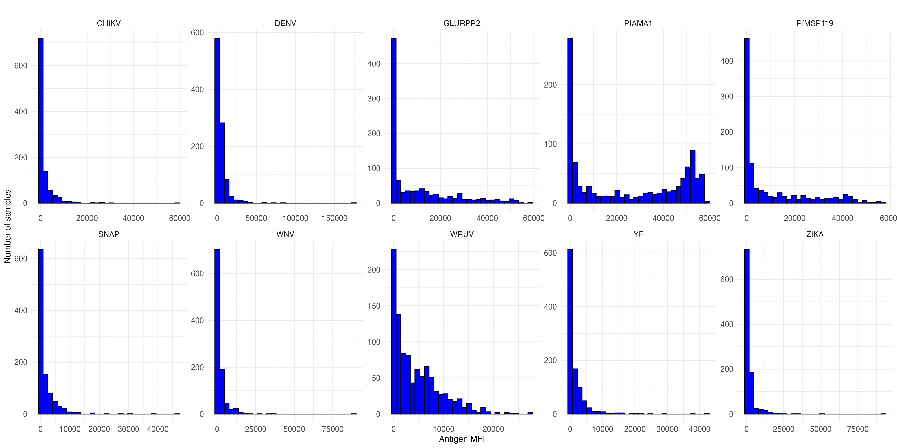
Visualizing serological data with histograms
How would you compare the different distributions of data (untransformed)?

Slide 4
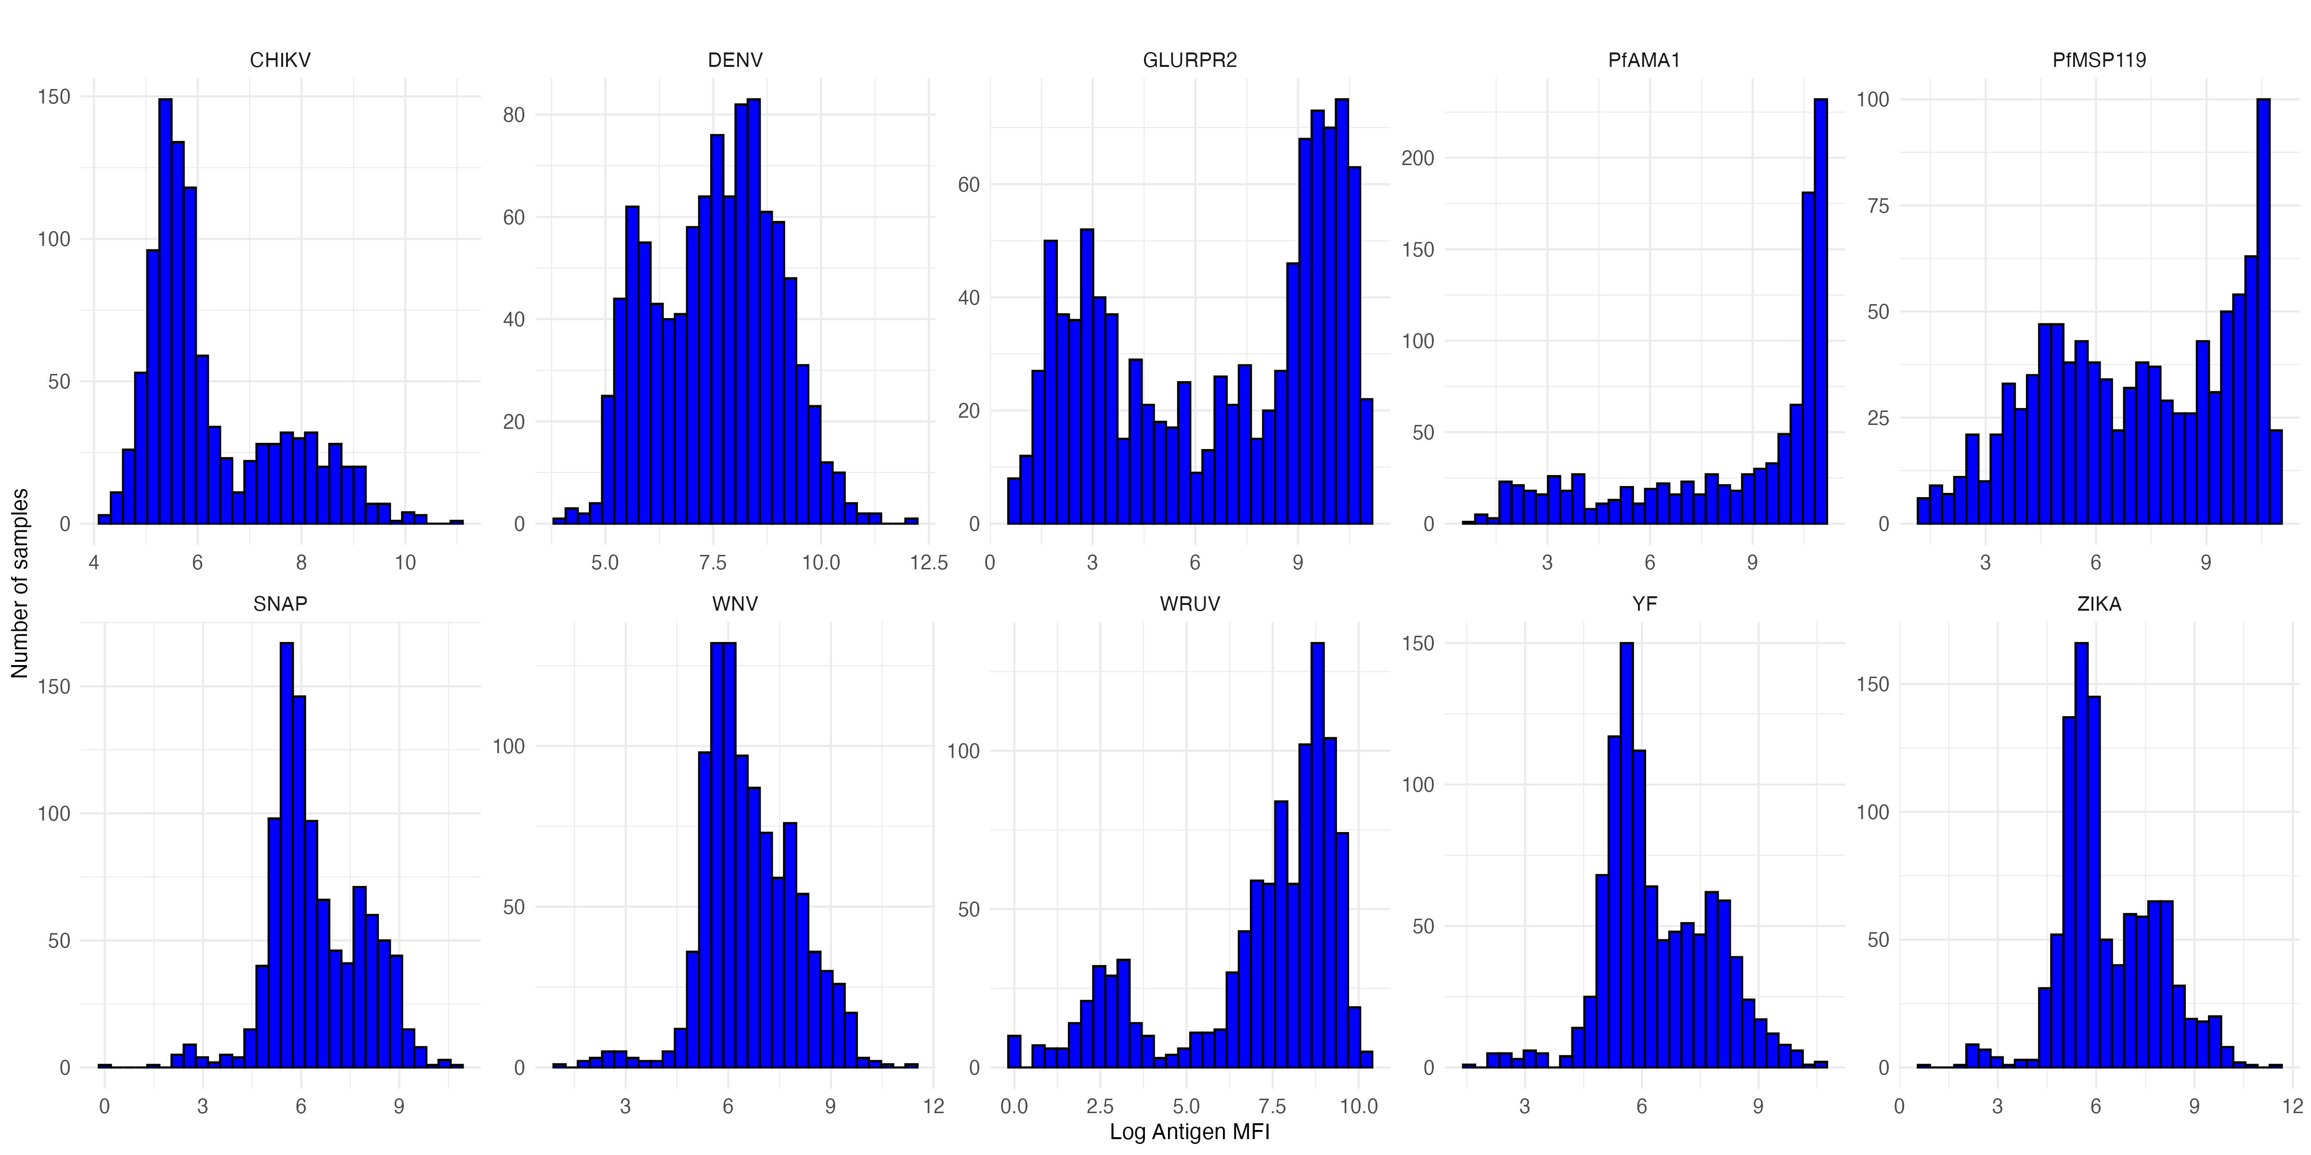
Visualizing serological data with histograms
How would you compare the different distributions of data (log transformation)?

Slide 5
Visualizing serological data with histograms
How would you compare the different distributions of data?
Skewed vs. non-skewed distributions
Unimodal vs. bimodal vs. multimodal
Narrow or wide distribution
Are there outliers?

Slide 6
Visualizing serological data with histograms
What underlying differences might cause the different distributions of data?

Slide 7
Visualizing serological data with histograms
What underlying differences might cause the different distributions of data?
Mix of exposed and unexposed in population
Mix of vaccinated / unvaccinated
Waning antibody responses

Slide 8
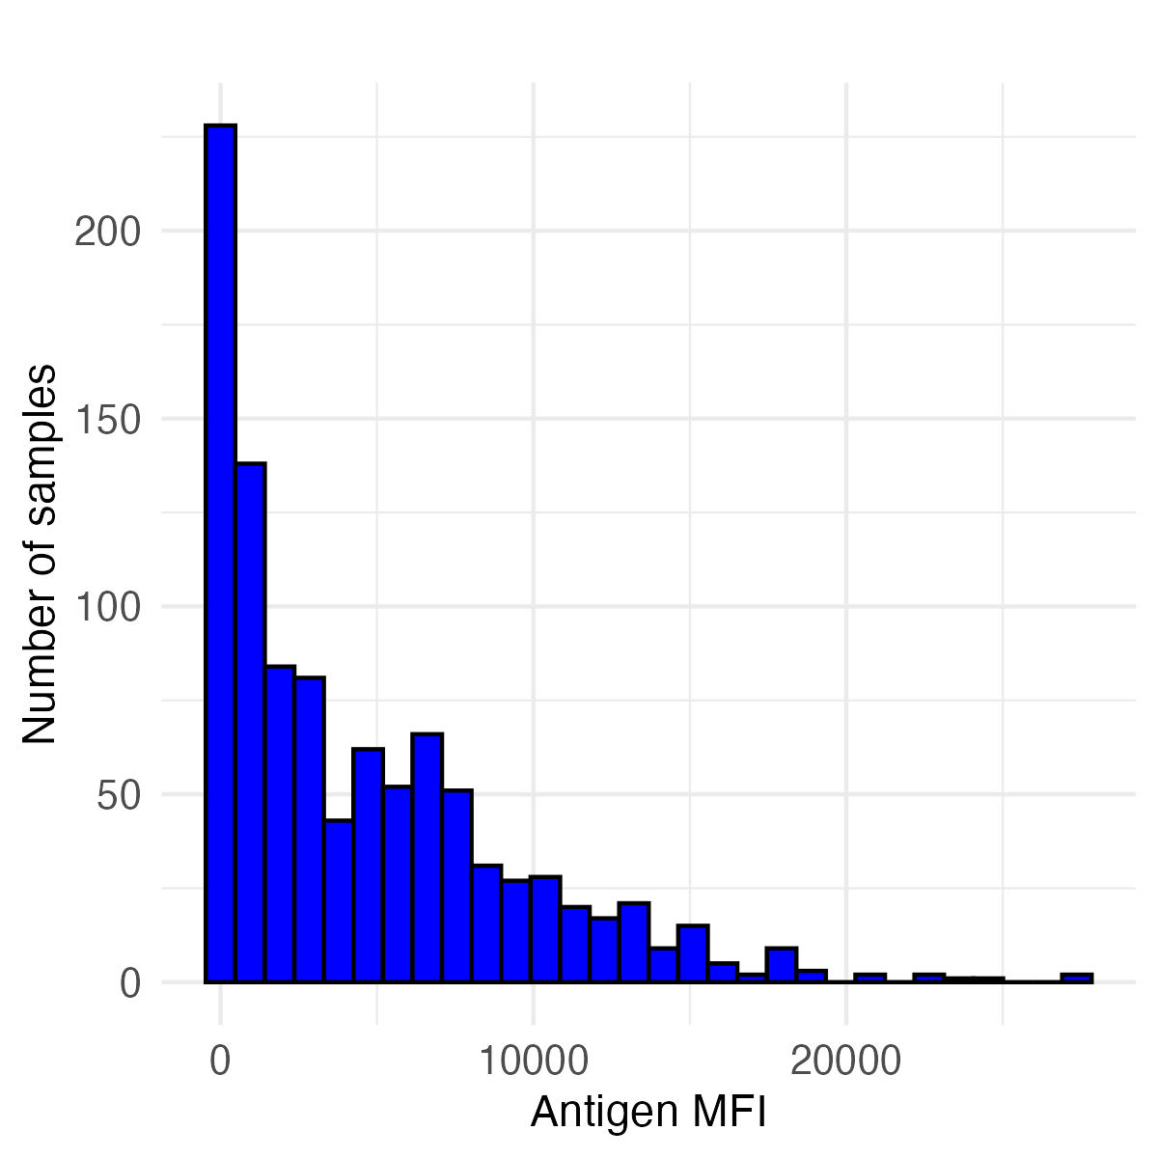
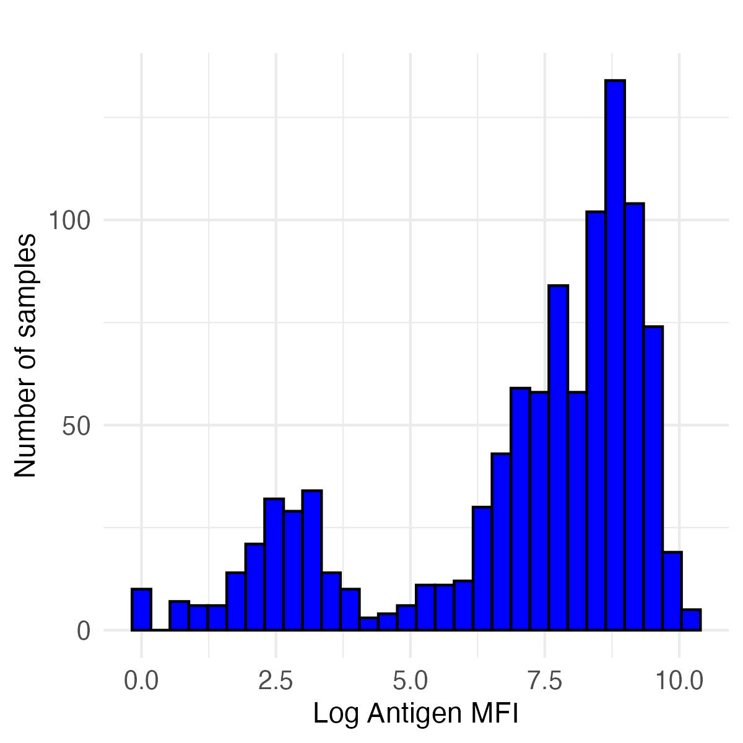
Histograms of rubella (wruv) antibody responses
Untransformed MFI Values Log transformed MFI values
How to get information from histograms like these?
How to compare the results of different histograms?
What inferences can we make about pathogen exposure based on a histogram?
A method of making inferences from distributions is binarizing data
Setting a cutoff, and everything above that cutoff is positive

Slide 9
Histograms of rubella (wruv) antibody responses
Untransformed MFI Values Log transformed MFI values
Rubella has a correlate of protection
Individuals with antibody responses above a certain cutoff are expected to be protected from rubella infection
By applying a cutoff equivalent to the correlate of protection, we can calculate seroprevalence (here, also equals the immune proportion)

Slide 10
Histograms of rubella (wruv) antibody responses
Untransformed MFI Values Log transformed MFI values
Rubella correlate of protection is 9.36 IU/ml (International Units per milliliter)
However, the Luminex assay gives us antibody units in MFI (median fluorescence intensity)
We can convert between MFI and IU/ml using a standard curve: we convert all MFI values to IU/ml, and apply the 9.36 IU/ml cutoff

Slide 11

Getting MFI values from standard curves
The standard curve is created using known concentrations of antibody standards (e.g., the WHO International Standard for rubella, below), ideally measured on the same plate(s) as the unknown samples.
https://nibsc.org/documents/ifu/RUBI-1-94.pdf

Slide 12
Converting MFI values to standardized units (IU/ml) from standard curves
(Recall we used standard curves to estimate relative antibody units.)
First, we fit a model to our standard curve data to establish the relationship between MFI values and known IU/mL concentrations.
Then, we can use this model to convert MFI values for the samples of interest to IU/ml.
Lastly, we apply the 9.36 IU/ml correlate of protection cutoff to the samples of interest to determine a binary serostatus for each sample.
Notes:
Please note that the cutoff value of rubella 9.36IU/mL comes from the following analysis: https://pmc.ncbi.nlm.nih.gov/articles/PMC8316076/ wherein “the ROC analysis for the RuV WVA MBA was performed on 152 paired serum samples (Table 1), using the quantitative ELISA as a classifier and resulted in an AUC of 1, a sensitivity of 99%, and a specificity of 100%, with a cutoff of 9.36 IU/ml (Fig. 8E)."

Slide 13
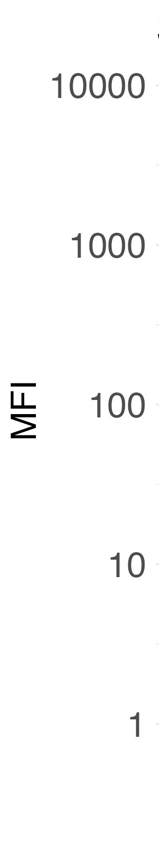
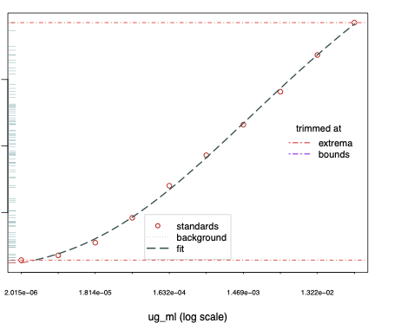
Converting MFI values to standardized units (IU/ml) from standard curves
For rubella (WRUV), we can apply the cutoff (based on correlate of protection) of 9.36 IU/ml to determine individual serostatus
cutoff (9.36 IU/mL)
observed sample data
1 10 100
WRUV concentration (IU/mL)

Slide 14
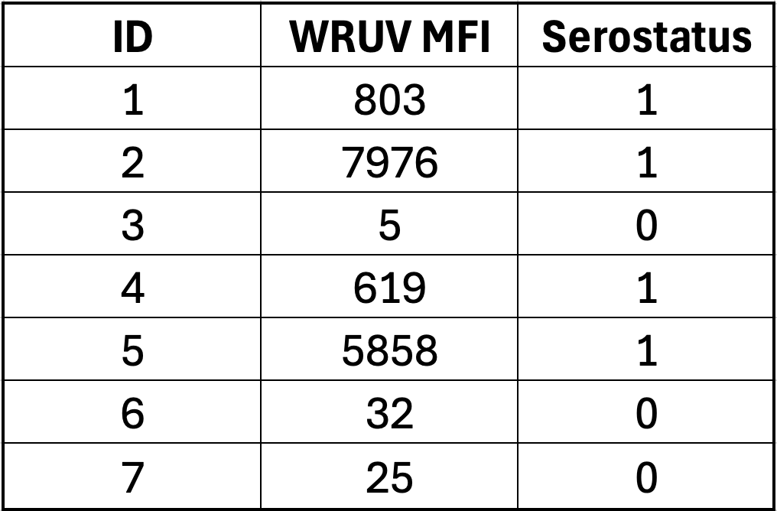
Determining serostatus from a cutoff
For each sample in the dataset, we identify each as seropositive (1) or seronegative (0)

Slide 15
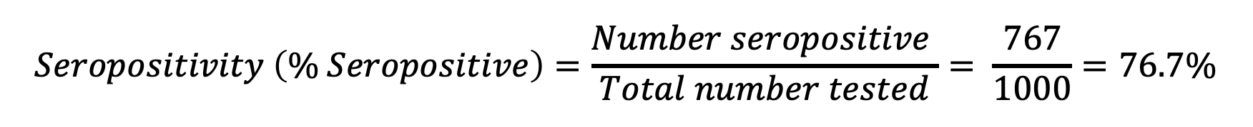
Calculating seropositivity or seroprevalence
For WRUV with a cutoff of 9.36 IU/ml, we have:
767 seropositive samples
233 seronegative samples
$$Seropositivity \left(\% Seropositive\right)=\frac{Number seropositive }{Total number tested}= \frac{767}{1000}=76.7\%$$

Slide 16
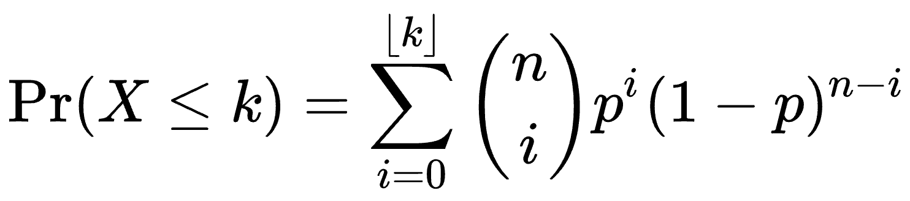
Calculating seropositivity – confidence intervals
Estimating uncertainty is important for capturing true population seroprevalence; it typically accounts for variance around a mean estimate.
Estimating a 95% confidence interval means that in 95 out of 100 calculations of seroprevalence from the same source population using 1000 individuals, the range will include the true population-level seroprevalence.
This method uses a binomial distribution and accounts for the number of people sampled – luckily, we can use R to easily compute it:
With 767 positive individuals and 1000 individuals total, the 95% CI is: 74.0% - 79.3%.

Slide 17
Calculating seropositivity – confidence intervals
With 767 positives and 1000 total samples:
Seroprevalence = 76.7% (95% CI: 74.0%, 79.3%)

Slide 18
Question: How do we interpret seroprevalence?
Interpretation strongly depends on how seroprevalence is determined, including controls used and selected cutoff.
For the seroprevalence of rubella (WRUV):
Percentage of people who have been exposed to vaccine or natural infection.
If we know there’s no/little vaccination, we may assume seroprevalence is due to natural infection, or vice versa.
Since cutoff is a correlate as protection, seroprevalence could also indicate which individuals are susceptible to future infection, and whether there could be outbreaks in a region.

Slide 19
Question: How do we interpret seroprevalence?
How would we interpret seroprevalence if there is NOT a correlate of protection?

Slide 20
Question: How do we interpret seroprevalence?
How would we interpret seroprevalence if there is NOT a correlate of protection?
For antigens in general, seroprevalence could indicate:
Population ever exposed to pathogen or vaccine
Population with recent infection
Population with symptomatic infection
Cross-reactive antibody responses

Slide 21
Controls
If we don’t have a correlate of protection, we can use control samples to determine cutoffs for seropositivity.
Ideally, we could have positive and negative controls.
Often, we only have negative controls, and sometimes we don’t have positive or negative controls.
The controls we use to establish cutoffs can affect our interpretation of seroprevalence.

Slide 22
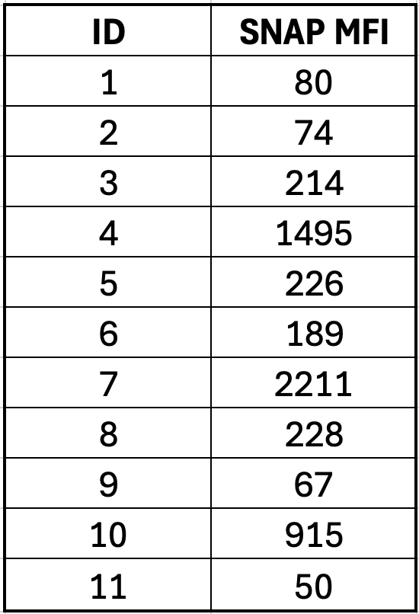
Non-target antigen controls
We also have controls with non-target antigens (SNAP in our dataset, other common ones are GST and Vero cell).
These controls can ensure that the plate ran correctly, whether values are similar between plates, and high values can indicate non-specific binding.
The non-target antigen values should ideally not differ between samples with high and low antigen values.

Slide 23
Positive controls
Often, positive controls are based on antibody responses from people who have symptomatic disease.
How might positive controls differ from positives in samples?

Slide 24
Positive controls
Often, positive controls are based on antibody responses from people who have symptomatic disease.
How might positive controls differ from positives in samples?
Vaccination vs. natural infection
Intensity of infection – severe, symptomatic, asymptomatic – (controls may be more likely to have clinical or severe infection)
Timing since infection (controls likely were taken from acute infection phase)

Slide 25
Negative controls
What populations might be best to get negative controls from?

Slide 26
Negative controls
What populations might be best to get negative controls from?
Non-endemic area (likely to be adults)
Very young presumed unexposed (likely to be from target population)

Slide 27
Negative controls
What populations might be best to get negative controls from?
Non-endemic area (likely to be adults)
Very young presumed unexposed (likely to be from target population)
Why would you choose to get - or not get - controls from each of these populations?

Slide 28
Negative controls
What populations might be best to get negative controls from?
Non-endemic area (likely to be adults)
Very young presumed unexposed (likely to be from target population)
Why would you choose to get - or not get - controls from each of these populations?
Controls from non-endemic area may differ from target population in many ways (geographic, socioeconomic, disease history)
Very young immune systems vs. adult immune systems

Slide 29
Controls
You may not have ideal controls.
You should understand the assumptions/biases of your controls!

Slide 30
Conclusions
You should visualize your data before conducting analysis.
It can be useful to classify samples as seropositive and seronegative, and to calculate seropositivity.
It’s important to understand the controls you use, and how these will affect your inference.

